Slide 1

Indicators for sustainable energy
Masoud abdi

Slide 2
Sustainable energy development
Sustainable energy development has become an international policy
A total of 57 indicator sets were found that monitor progress towards sustainable energy development or some aspects of it.
In 2000, the concept of sustainable energy development (SED) was put forward in the UN’s World Energy Assessment
the necessity of secure and reliable energy supply at an affordable price was highlighted
current indicators have been criticized for their limited scope and perspective, lack of transparency

Slide 3
Sustainable energy development
First : Climate Change and Kyoto Protocol
In 2000, the United Nations Development Programme (UNDP), in its World Energy Assessment (WEA) report, put forward a new development paradigm where the economic, environmental, and social impacts of energy development
SED were presented:
sustainable energy supply, access to affordable modern energy services, energy security, and sustainable energy consumption
This transformation will include a transition in energy generation towards environmentally sound technologies and modern renewables that are managed sustainably

Slide 4
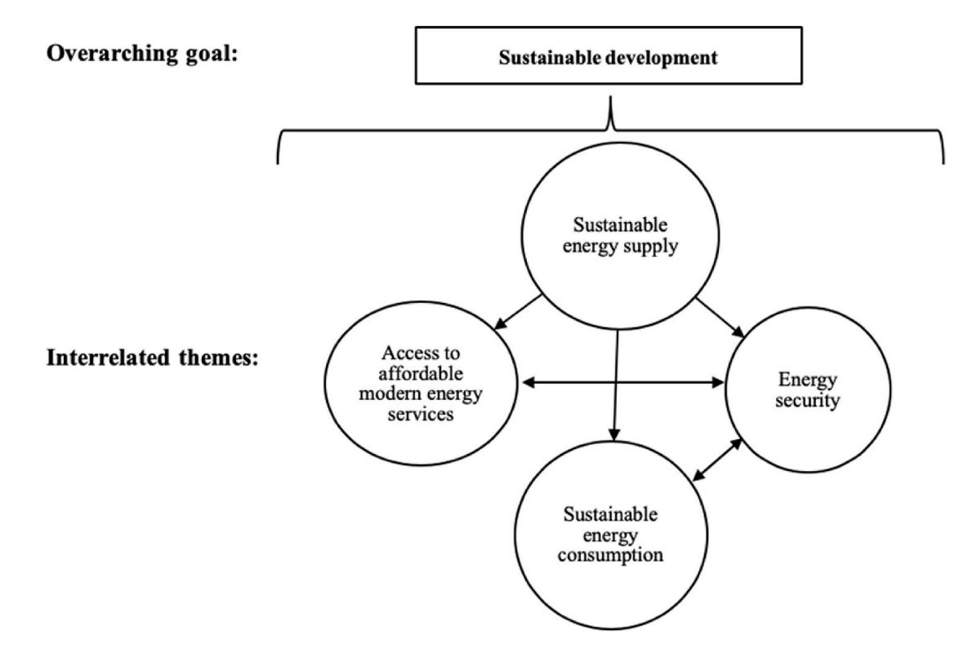

Slide 5
Limitations of sustainability indicators
limitations include failure to capture unique national circumstances, an imbalanced representation of the dimensions of SD, inconsistent results, obscure methodology, and lack of stakeholder engagement
Every country has a different programme but SED follow the same concept for all countries

Slide 6
Frameworks for indicator selection
The benefits of frameworks are multiple, such as increased comparability, transparency of indicator selection, and minimized bias
Three main types of frameworks have been utilized for the development of indicator sets for SED: causal chain, thematic, and system dynamics ones.
Causal chain frameworks :
In 2002, the IAEA presented its Indicators for Sustainable Energy Development (ISED) that were based within a causal chain framework

Slide 7
Frameworks for indicator selection
Thematic frameworks :
Thematic frameworks are those that group indicators into different issues or themes of sustainability
the Energy Indicators for Sustainable Development (EISD) were presented, which contained the same core set of indicators organized within different themes of SED

Slide 8
Frameworks for indicator selection
System dynamics frameworks
A mixed approach :
A mixed approach is the combination of different frameworks, usually a thematic framework

Slide 9
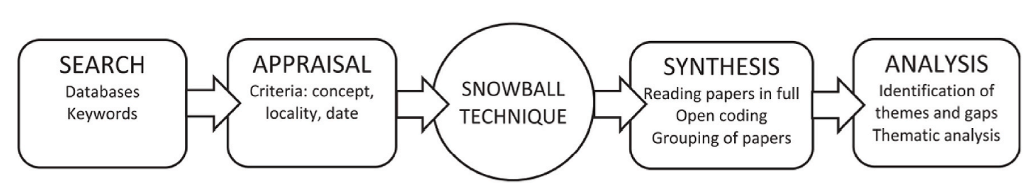
SALSA framework
A literature review was conducted to identify what indicators for SED exist.
time and geographical scope did not limit this search.
systematic search and review of the literature were carried out through the application of the Search, Appraisal, Synthesis, and Analysis (SALSA) framework

Slide 10
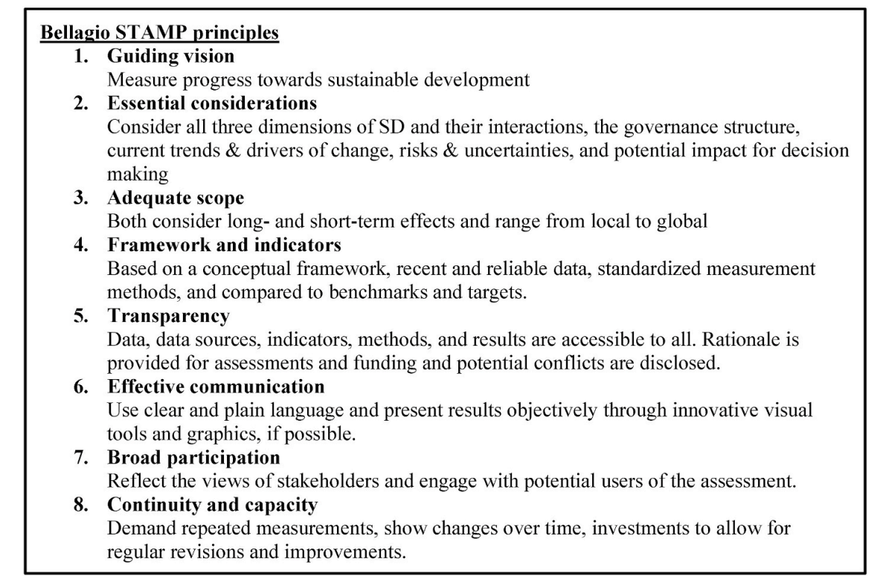
Bellagio STAMP principles

Slide 11
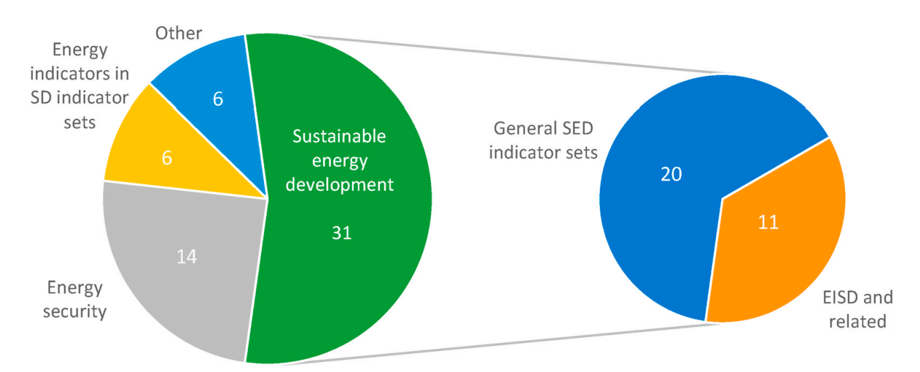
Categories of indicator sets

Slide 12
Indicator set assessment criteria. Compiled by authors
Set grade for each indicator with concept of below
1. Transparency of indicator selection
2. Transparency of indicator application
3. Conceptual framework
4. Representative
5. Linkages
6. Stakeholder engagement

Slide 13
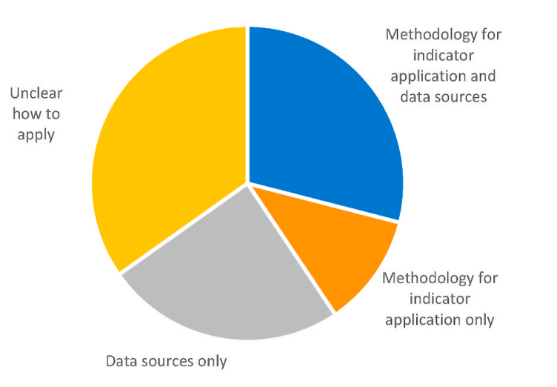
Transparency of indicator application
Only 20 indicator sets included both the methodology for indicator application and data sources

Slide 14
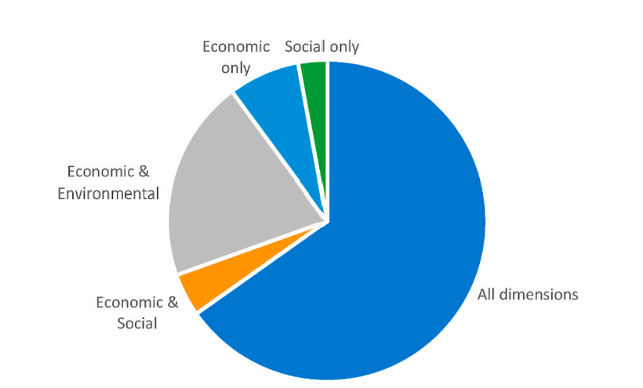
Representative
Most indicator sets considered all three dimensions of sustainable development

Slide 15
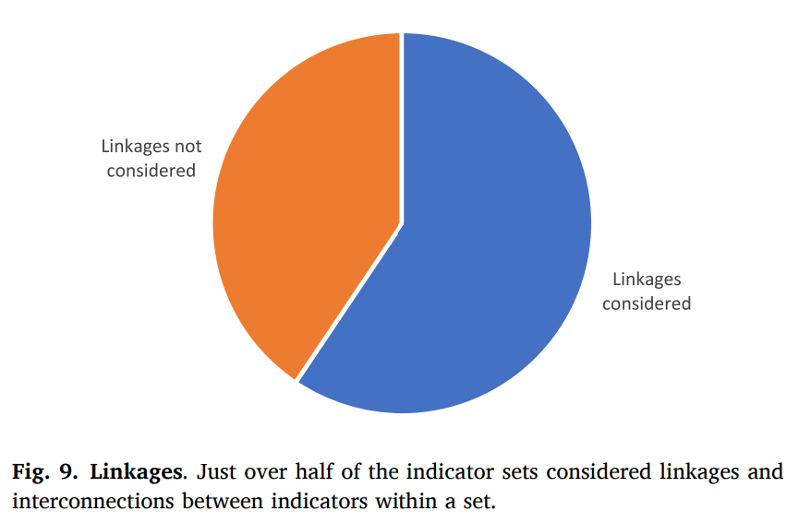
Linkages

Slide 16
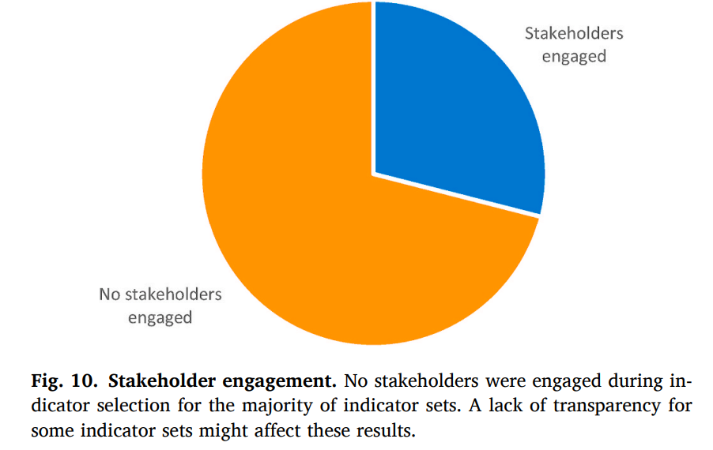
Stakeholder engagement

Slide 17
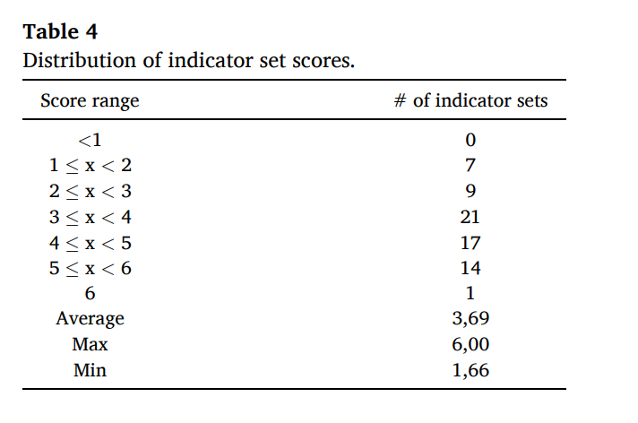
Distribution of indicator set scores.

Slide 18
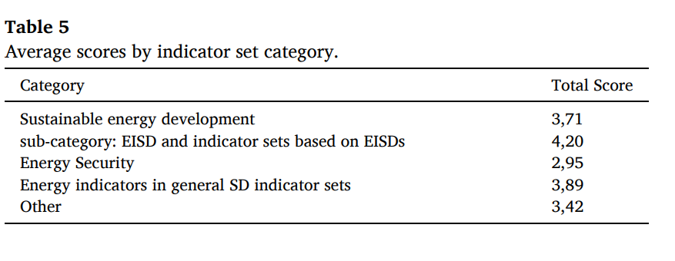
Average scores by indicator set category

Slide 19
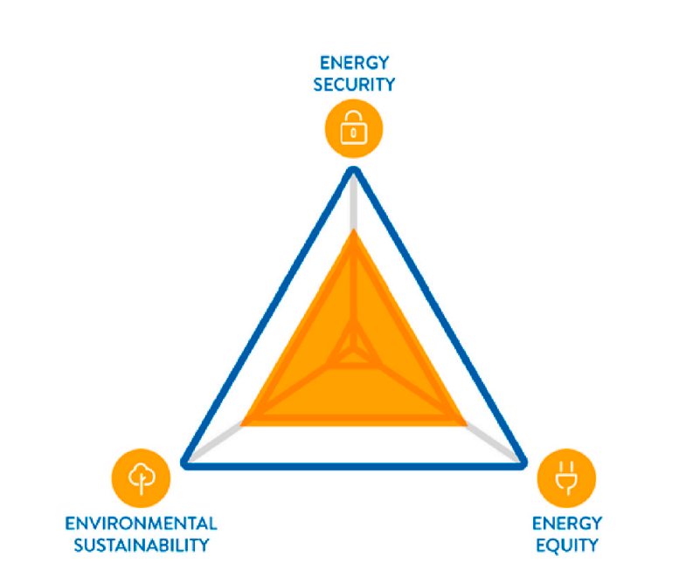
The Energy Trilemma (ETI)

Slide 20
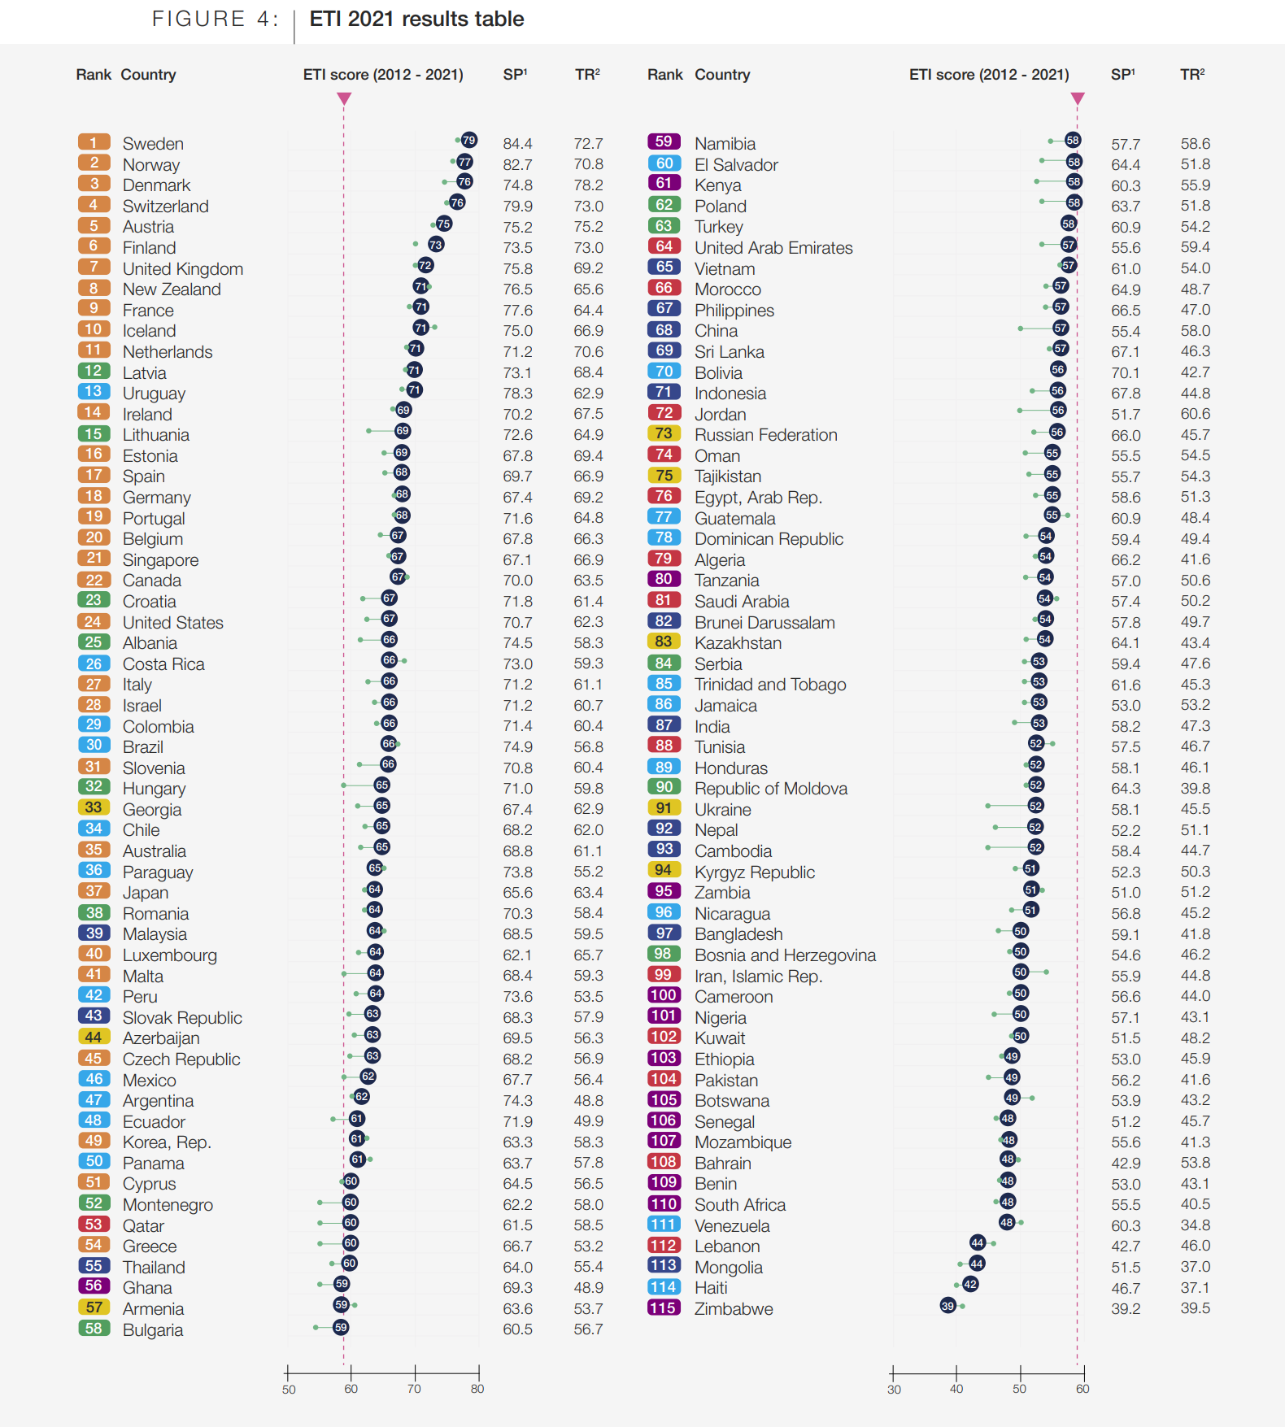

Slide 21
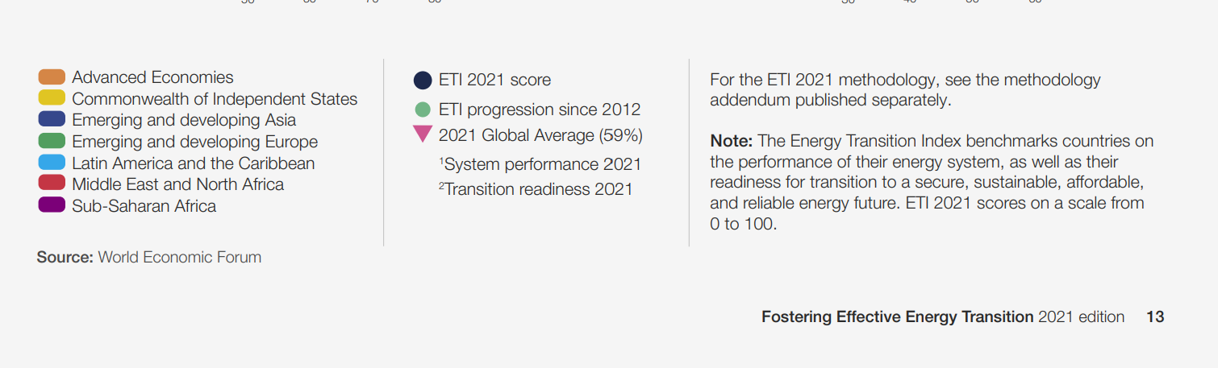

Slide 22
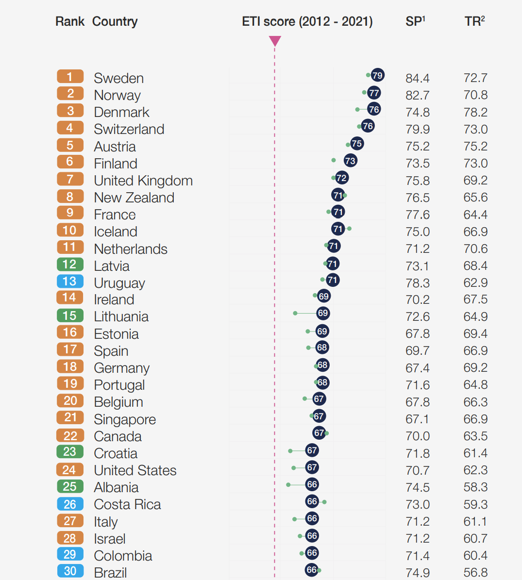

Slide 23
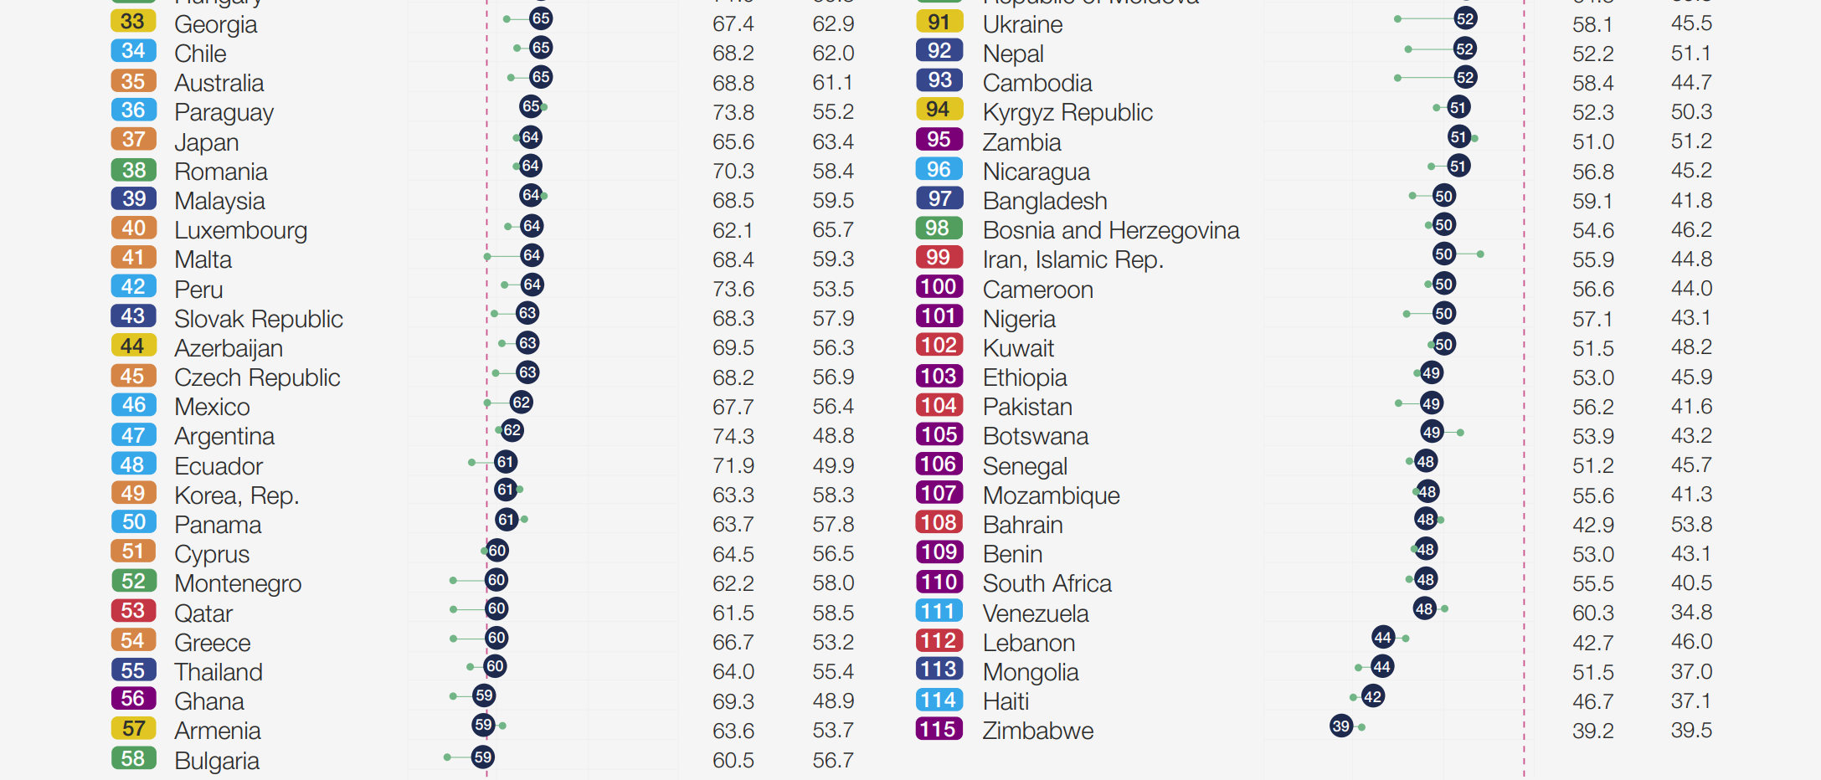

Slide 24
Appendix A. Identified indicator sets for sustainable energy development
THANKS FOR YOUR ATTENTION

